Slide 1

Matthew D. Groves: Don’t Try This At Home
Create a class at runtime using Reflection.Emit

Slide 2
Sane way to create a string
var myString = “hello, world”;

Slide 3
Insane way to create a string
var sb = new StringBuilder();
sb.Append(“hello, world!”);
var myString = sb.ToString();

Slide 4
Sane way to instantiate
var myObj = new MyClass();
myObj.Name = “Larry Csonka”;
Console.WriteLine(myObj.Name);

Slide 5
Insane way to instantiate
var myObj = (MyClass)Activator.CreateInstance(typeof(MyClass));
myObj.Name = “Larry Csonka”;
Console.WriteLine(myObj.Name);

Slide 6
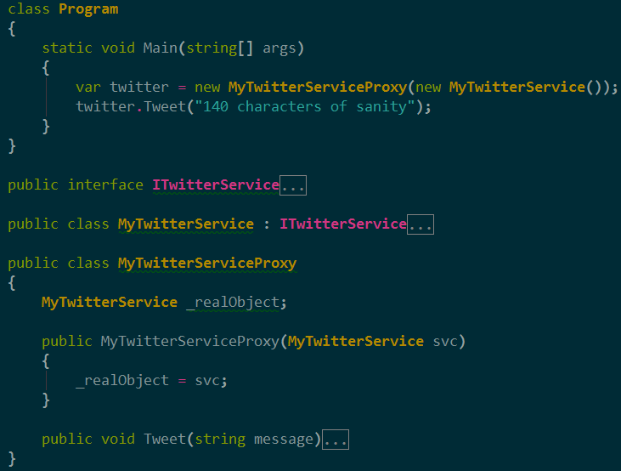
Sane way to create a class

Slide 7
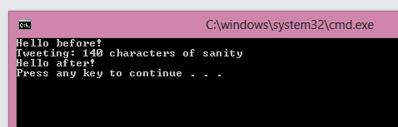

Slide 8
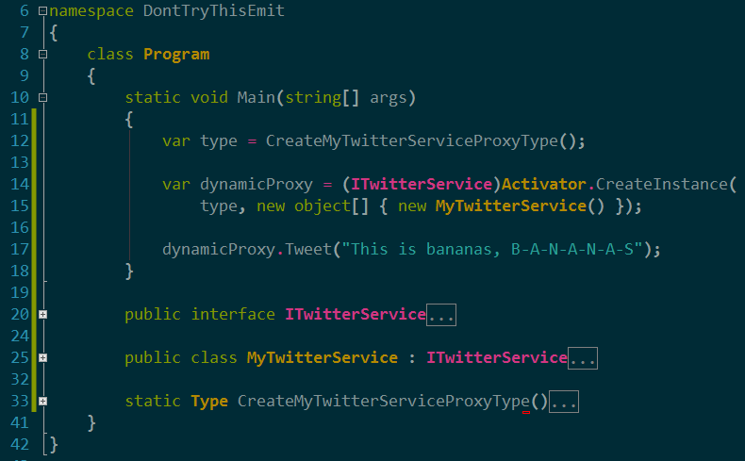
Insane way to create a class

Slide 9
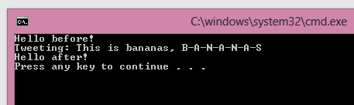

Slide 10
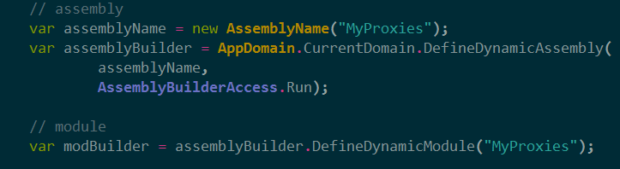
Create assembly + module

Slide 11
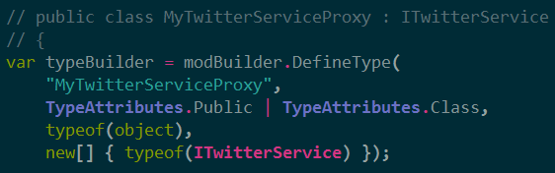
Declare class that implements interface

Slide 12
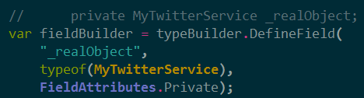
Declare private field

Slide 13
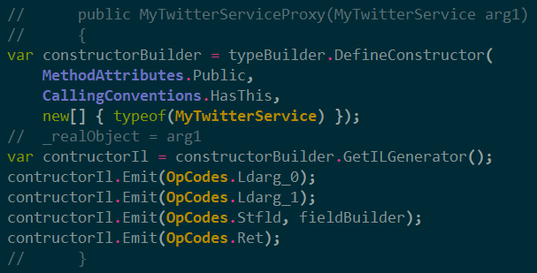
Declare constructor with parameter

Slide 14
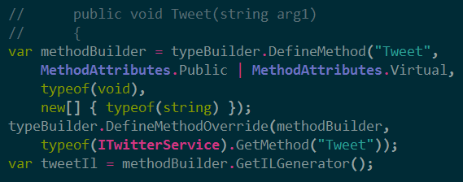
Declare ‘Tweet’ method with one parameter

Slide 15
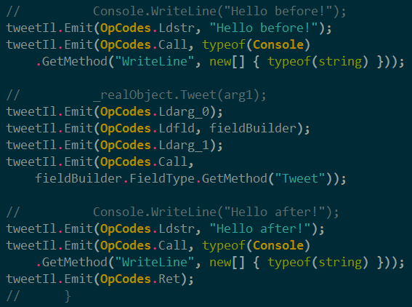
‘Tweet’ body: WriteLine, call Tweet, WriteLine again

Slide 16

Build the Type

Slide 17

http://about.me/mgroves
42% off at manning.com code:
13cmev

